Slide 1
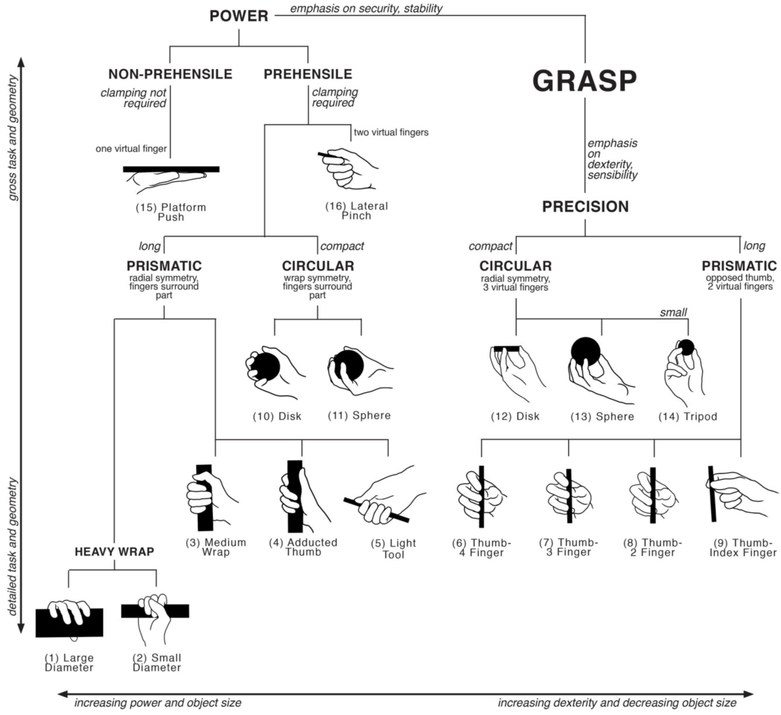
Patient Name
Hand Function Chart with and without prosthesis
Patient can perform without prosthesis
Additional grasps patient can perform
with Naked Prosthetics prosthesis
Cutkosky MR. On Grasp Choice, Grasp Models, and the Design of Hands for Manufacturing Tasks. IEEE Transactions on Robotics and Automation 1989;5(3):269-79.

